Slide 1
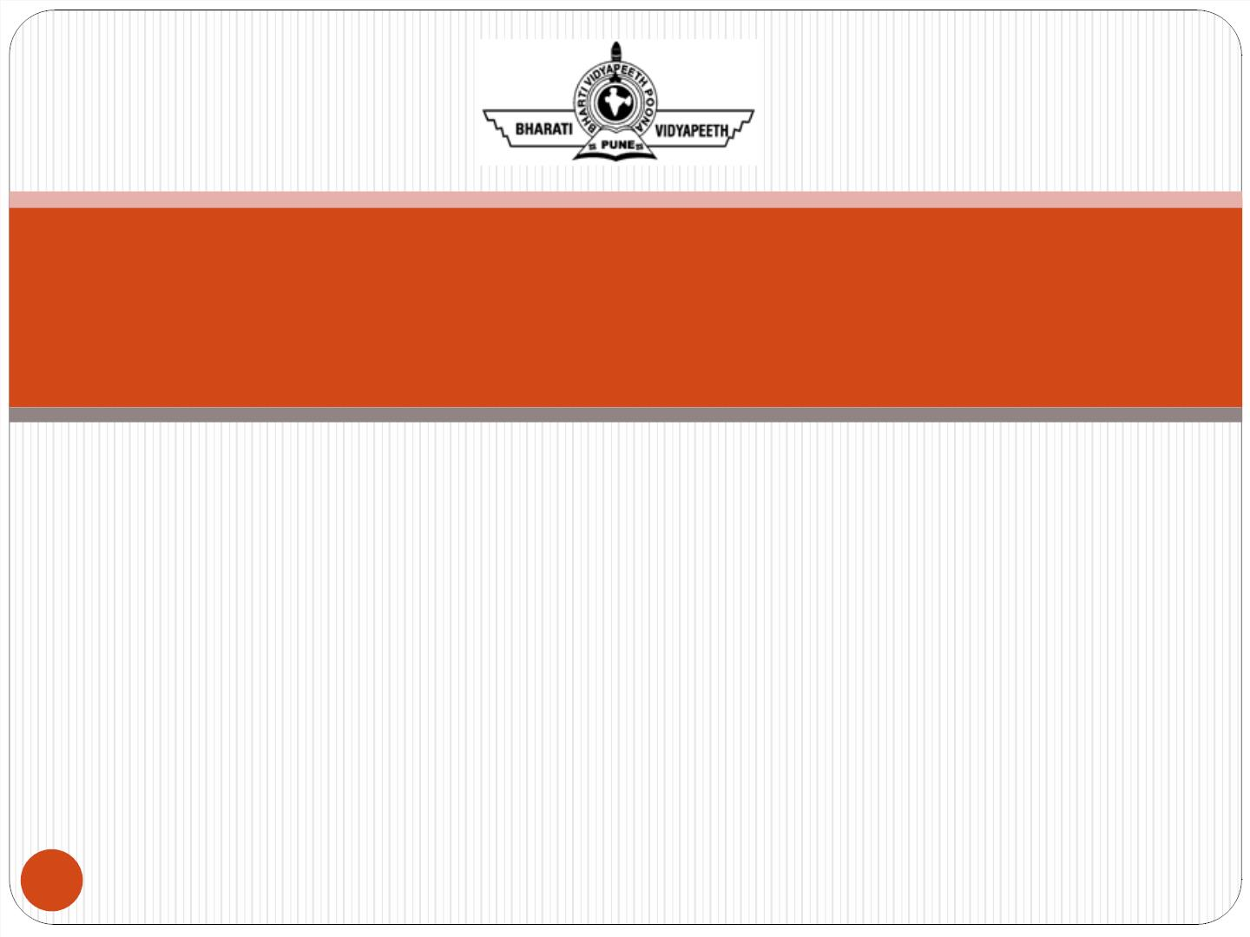
UNIT -2
Mobile Data Link Layer & Bluetooth
VIII SEMESTER
Mobile Computing
ETIT-402
1

Slide 2

Mobile Data Link Layer
Wireless Lan Overview (IEEE 802.11a/b/g/n)
MAC Motivation
Multiple Access LANs
FDMA
TDMA
CDMA
LAN Protocol Architecture
Near and Far Terminals
CSMA
Polling
ISMA (Inhibit Sense Multiple Access)
HiperLan
2

Slide 3
Bluetooth
IEEE 802.15 Bluetooth User Case Scenarios
MAC Layer and Link Management
Local Area Wireless Systems:
WPABX
IrDA
ZigBee
RFID
WiMax
3

Slide 4
Book to be Referred
1) Mobile Computing by Rak kamal ,Chapter 6, Page No.- 271-291
2) Mobile Communication By Jochen Schiller,Chapter 9, Page
No. 351-365
4

Slide 5
Wireless Lan (IEEE 802.11)
802.11 b- In July of 1999, the Institute of Electrical Engineers (IEEE) expanded on the original WLAN standard and created 802.11b. Wireless B can be compared to traditional Ethernet since it supports a bandwidth up to 11 Mbps and the signal is good for around 150 feet. Routers with just 802.11b are no longer manufactured these days. A problem with 802.11b is that it operates at a frequency range of 2.4GHz which is the same frequency as many common household appliances and it can cause interference.
802.11 a- Wireless A or 802.11a was actually created around the same time as 802.11b. Wireless B gained more popularity when the wlan standard came out which makes many people believe that 802.11a came out before 802.11b. Wireless A supports up to 54 Mbps of bandwidth, operates at a frequency range around 5 GHz, and there is no signal interference. Wireless A is more expensive so it is found more on business networks. 802.11a and 802.11b operate at different frequencies so they are incompatible with each other.
5

Slide 6
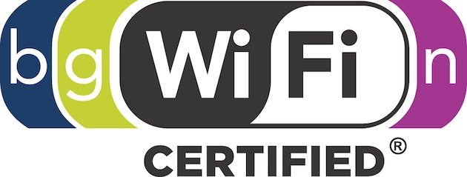
Wireless Lan (IEEE 802.11)
802.11 g- Wireless G operates at the same frequency range of Wireless B at 2.4 GHz which means it has interference issues as well. It supports up to 54 Mbps of bandwidth and it is backward compatible with 802.11b devices. Wireless G is similar to Wireless B but it has more speed.
802.11 n- Wireless N operates at frequencies of both 2.4 GHz and 5 GHz. It supports up to 300 Mbps of bandwidth due to the utilization of multiple antennas. Speeds normally stay around 130 Mbps or less without specific configurations being met. The Wireless N has increased signal strength and power over the Wireless G.
6

Slide 7
MAC (Medium Access
Control)
In Layer 2 of a network, the Media Access Control (MAC) sublayer provides addressing and channel access control mechanisms that enable several terminals or network nodes to communicate in a network.
The MAC sublayer acts as an interface between the logical link control (LLC) Ethernet sublayer and Layer 1 (the physical layer). The MAC sublayer emulates a full-duplex logical communication channel in a multipoint network. This channel may provide unicast, multicast, or broadcast communication service. The MAC sublayer uses MAC protocols to prevent collisions.
In Layer 2, multiple devices on the same physical link can uniquely identify one another at the data link layer, by using the MAC addresses that are assigned to all ports on a switch. A MAC algorithm accepts as input a secret key and an arbitrary-length message to be authenticated, and outputs a MAC address.
7

Slide 8
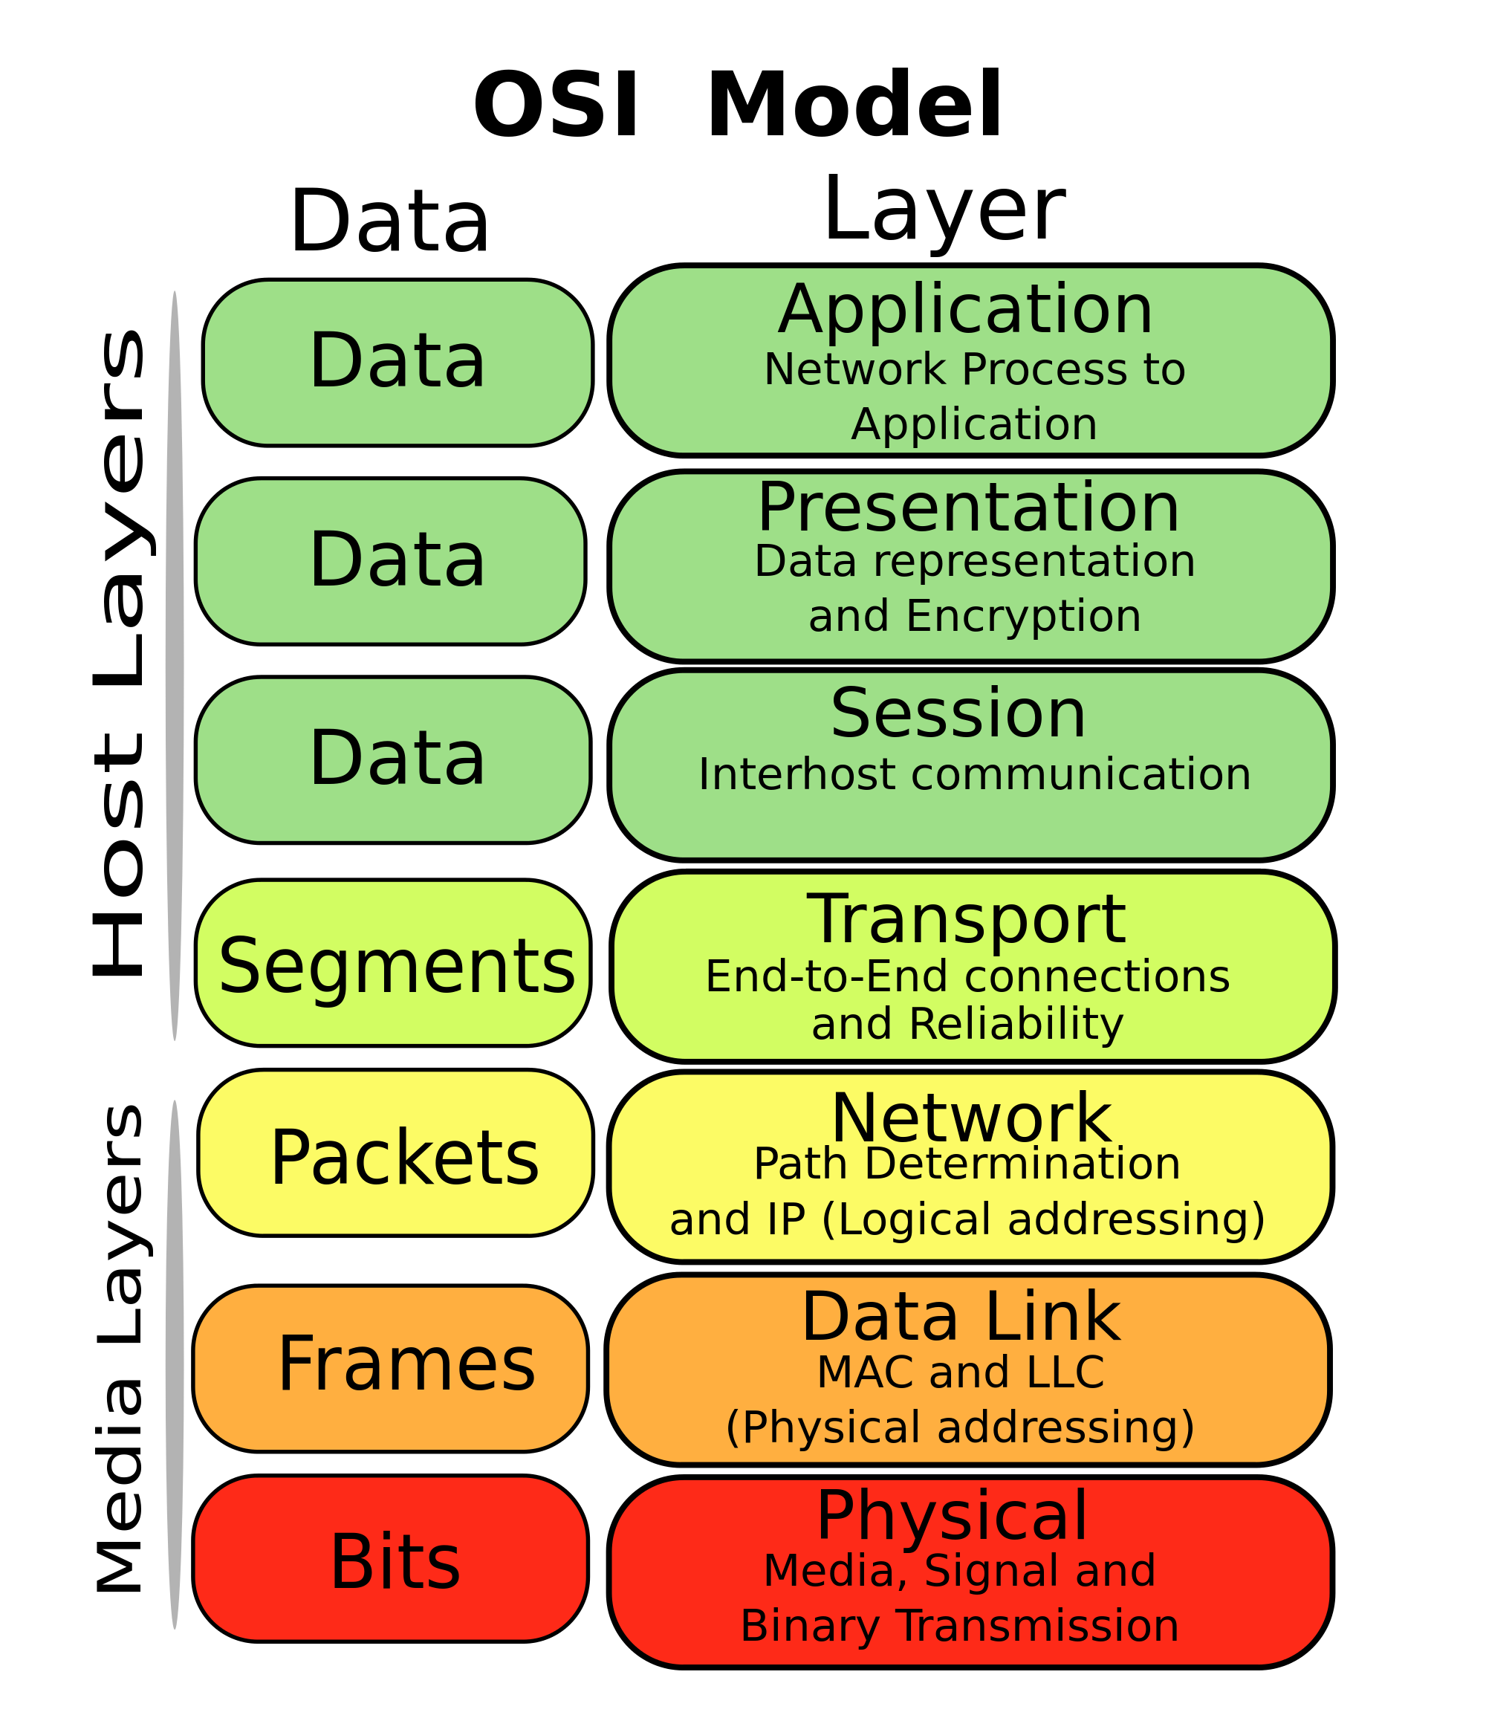
8

Slide 9
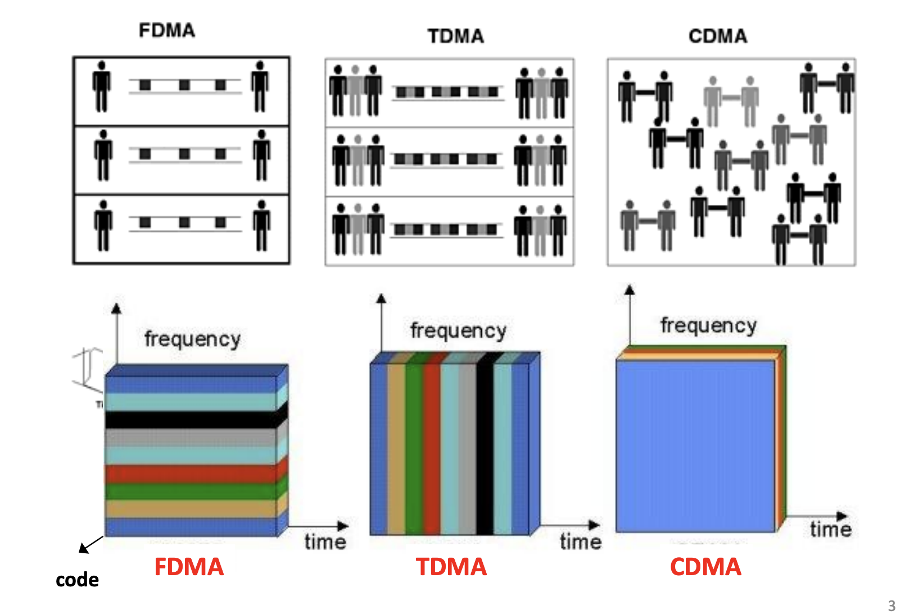
Types of Multiple Access Techniques
9

Slide 10
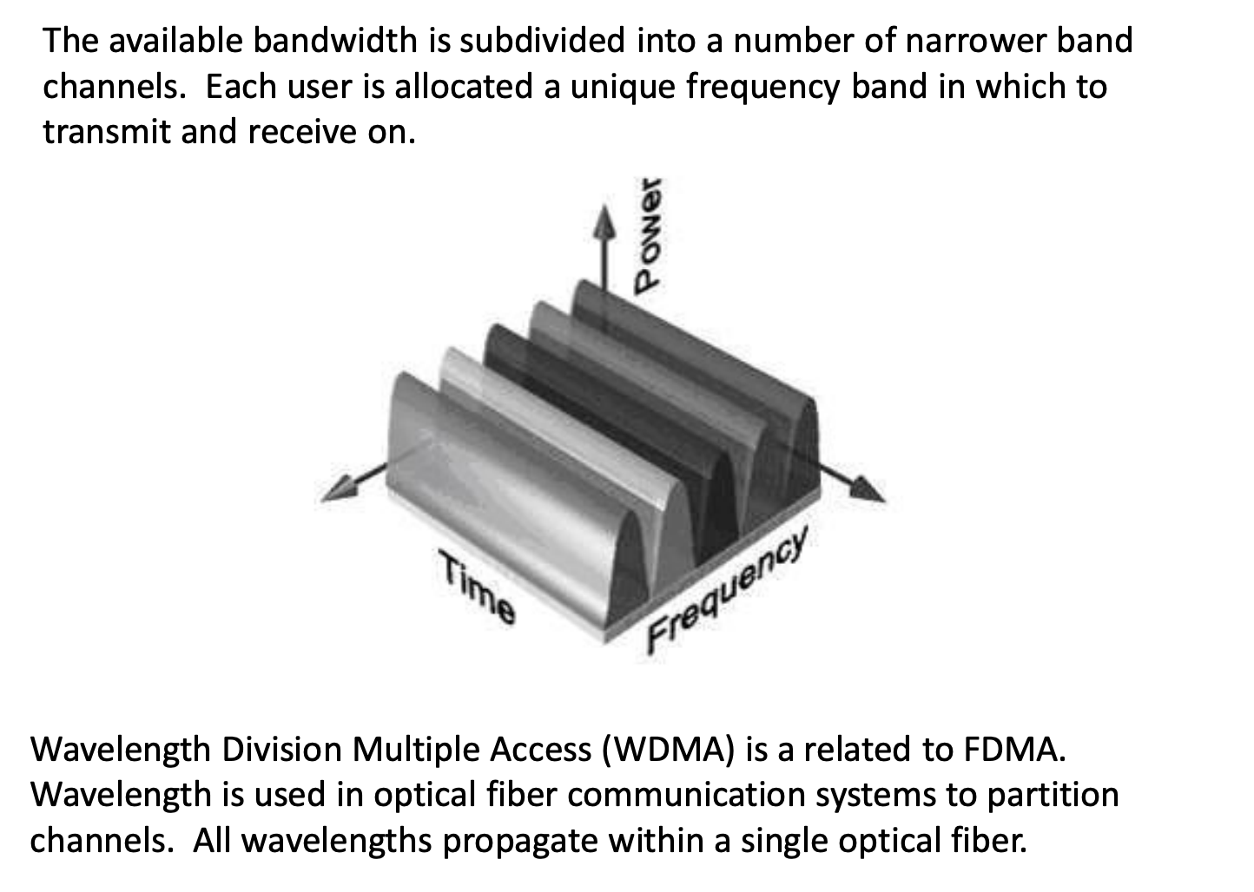
FDMA (Frequency Division Multiple Access)
10

Slide 11
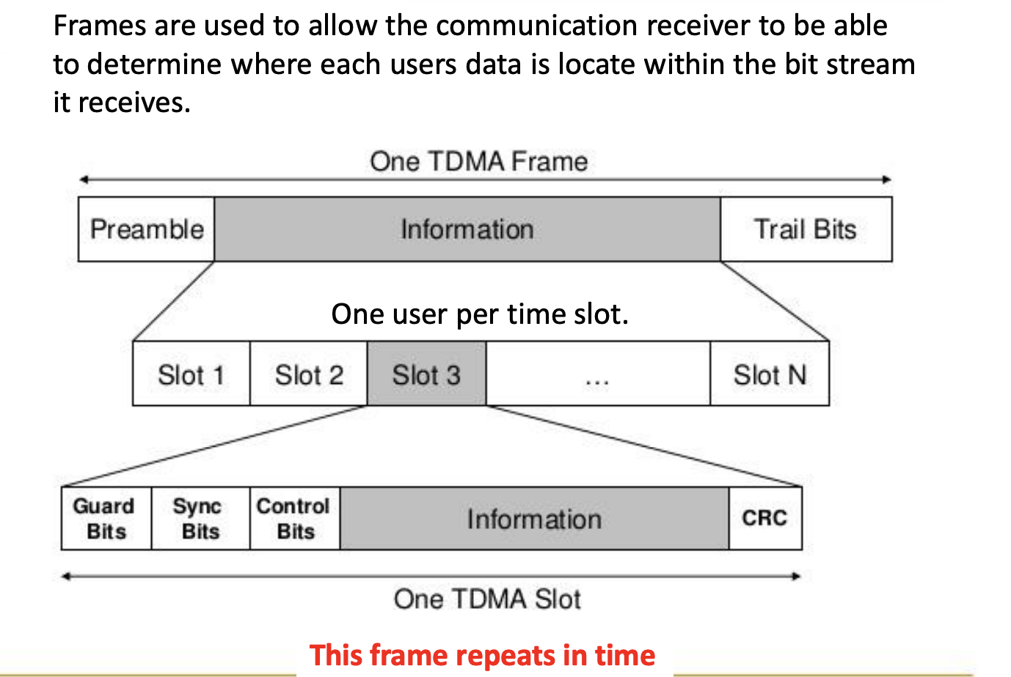
TDMA (Time Division Multiple Access)
11

Slide 12
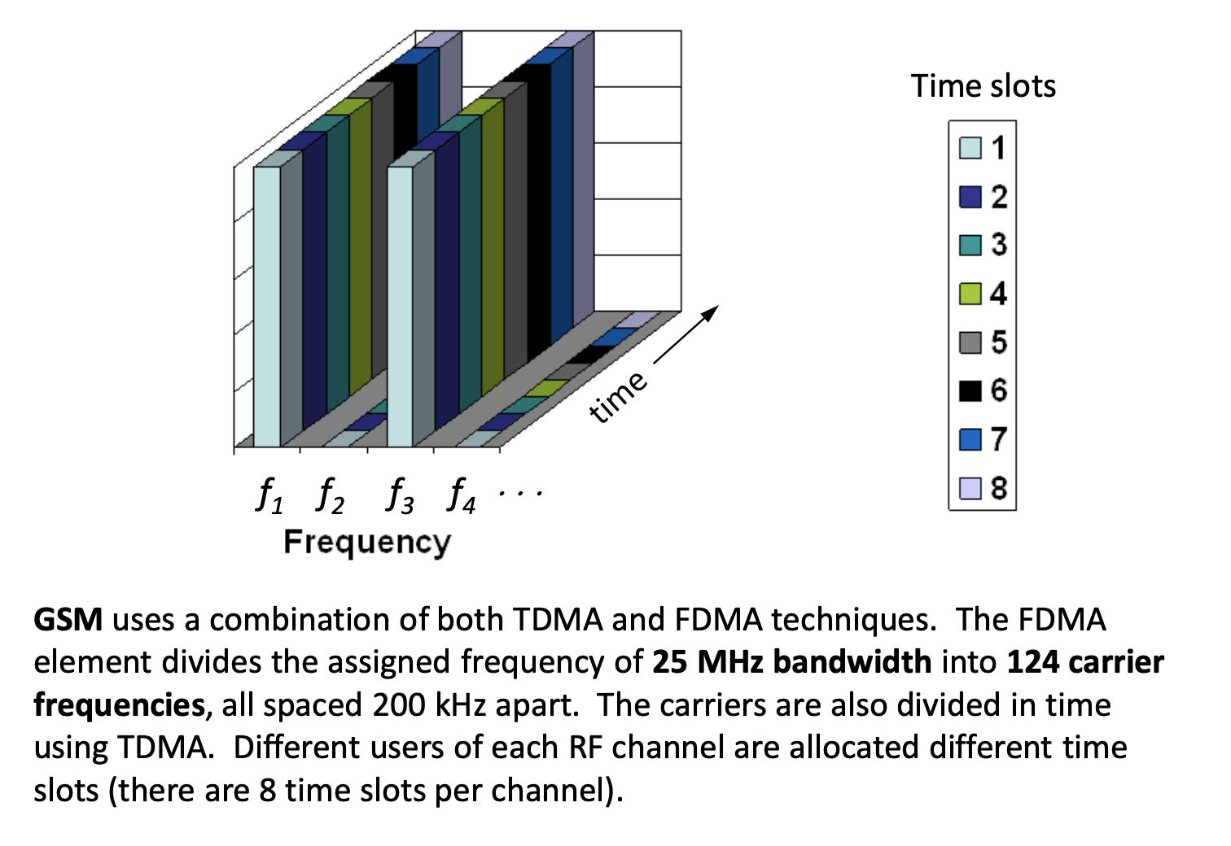
GSM (FDMA +TDMA)
12

Slide 13
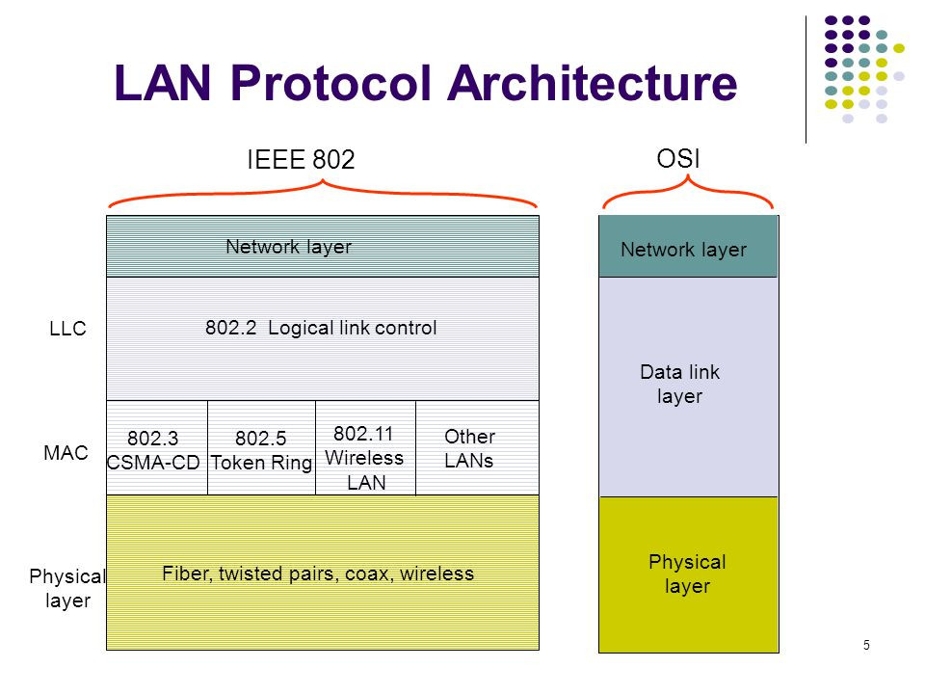
13

Slide 14
LAN Protocol Architecture
LAN protocol architectures are specified by IEEE 802 reference model
In IEEE 802 reference model, there are two separate layers corresponding to data link layer of OSI model
MAC (Medium Access Control) layer
LLC (Logical Link Control) layer
LLC Layer – Provides an interface to higher layers and gives flow and error control
MAC Layer – Its an interface to physical layer which governs access to LAN transmission system. It is responsible for sending/receiving frames, frame synchronization and error detection
Physical Layer – It specifies the transmission medium and the topology. Also responsible for encoding/decoding of signals. Preamble generation/ removal (for synchronization) and bit transmission/ reception.
14

Slide 15
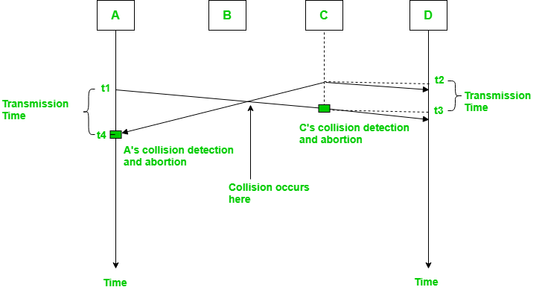
CSMA (Carrier Sense Multiple Access)
This method was developed to decrease the chances of collisions when two or more stations start sending their signals over the data link layer. Carrier Sense multiple access requires that each station first check the state of the medium before sending. In this method, a station monitors the medium after it sends a frame to see if the transmission was successful.If successful, the station is finished, if not, the frame is sent again.
15

Slide 16
This In the diagram, A starts send the first bit of its frame at t1 and since C sees the channel idle at t2, starts sending its frame at t2. C detects A’s frame at t3 and aborts transmission. A detects C’s frame at t4 and aborts its transmission. Transmission time for C’s frame is therefore t3 -t2 and for A’s frame is t4 -t1. So, the frame transmission time (Tfr) should be at least twice the maximum propagation time (Tp). This can be deduced when the two stations involved in collision are maximum distance apart.
The basic idea behind CSMA/CA is that the station should be able to receive while transmitting to detect a collision from different stations. In wired networks, if a collision has occurred then the energy of received signal almost doubles and the station can sense the possibility of collision. Most of the energy is used for transmission and the energy of received signal increases by only 5-10% if collision occurs. It can’t be used by station to sense collision. These are three type of strategies:
InterFrame Space (IFS) – When a station finds the channel busy, it waits for a period of time called IFS time. IFS can also be used to define the priority of a station or a frame. Higher the IFS lower is the priority.
Contention Window – It is the amount of time divided into slots. A station which is ready to send frames chooses random number of slots as wait time.
Acknowledgements – The positive acknowledgements and time-out timer can help guarantee a successful transmission of the frame.
16

Slide 17
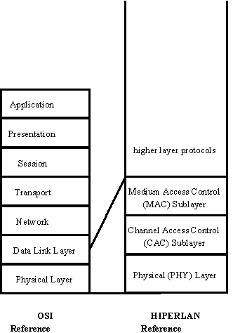
Hiperlan
HIPERLAN is a European family of standards on digital high speed wireless communication in the 5.15-5.3 GHz and the 17.1-17.3 GHz spectrum developed by ETSI. The committee responsible for HIPERLAN is RES-10 which has been working on the standard since November 1991.
The standard serves to ensure the possible interoperability of different manufacturers' wireless communications equipment that operate in this spectrum. The HIPERLAN standard only describes a common air interface including the physical layer for wireless communications equipment, while leaving decisions on higher level configurations and functions open to the equipment manufacturers.
17

Slide 18
Bluetooth: IEEE Standard
This IEEE Standards product is part of the 802 family on LAN/MAN.
The lower transport layers [(Logical Link Control and Adaptation Protocol (L2CAP), Link Manager Protocol (LMP), baseband, and radio] of the Bluetooth™ wireless technology are defined.
Bluetooth is an industry specification for short-range radio frequency (RF)-based connectivity for portable personal devices. The IEEE 802.15.1 Task Group has reviewed and provided a standard adaptation of the Bluetooth specifications (version 1.1) medium access control (MAC) (L2CAP, LMP, and baseband) and physical layer (PHY) (radio).
Also specified is a clause on service access points (SAPs), which includes a logical link control (LLC)-MAC interface for the ISO/IEC 8802-2 LLC. A normative annex is included that provides a Protocol Implementation Conformance Statement (PICS) proforma, and an informative high-level behavioral ITU-T Z.100 specification and description language (SDL) model for an integrated Bluetooth MAC sublayer are also specified.
18

Slide 19
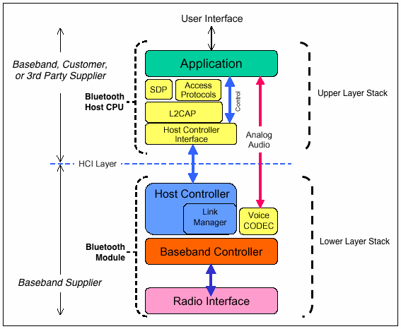
Bluetooth Architecture
19

Slide 20
Bluetooth Architecture
The radio layer is responsible for:
Modulation/Demodulation of data for transmitting/receiving over air.
The base band layer is responsible for:
Controlling the physical links via radio
Assembling the packets
Controlling frequency hopping.
The link manager protocol controls and configures links to other devices.
The host controller interface(HCI) handles communication between the host and the module. For this purpose, it uses several HCI command packets such as the even packets and data packets. The L2CAP layer converts the data obtained from higher layers into packets of different sizes.
The RF COMM provides a serial interface with wireless application protocol (WAP) and object exchange(OBEX).
WAP and OBEX provide interface to other communications protocols.
The TCS(Telephone control protocol specification) provide telephony service.
The SDP(Service discovery protocol) allows the devices to discover the services available on another Bluetooth enabled device.
The applications present in the application layer can extract the services of the lower layers by using one of the many profiles available.
20

Slide 21
Local Area Wireless System
WPABX
A private automatic branch exchange (PABX) is an automatic telephone switching system within a private enterprise. Originally, such systems - called private branch exchanges (PBX) - required the use of a live operator. Since almost all private branch exchanges today are automatic, the abbreviation "PBX" usually implies a "PABX."
Some manufacturers of PABX (PBX) systems distinguish their products from others by creating new kinds of private branch exchanges. Rolm offers a Computerized Branch Exchange (CABX) and Usha Informatics offers an Electronic Private Automatic Branch Exchange (EPABX).
21

Slide 22
Local Area Wireless System
IrDA
Infrared Data Association, or IrDA in short, is a group of device manufacturers that developed a standard for transmitting data via infrared (IR) light waves. It provides specifications for the complete set of protocols for wireless IR communication. The main reason for using IrDA had been wireless data transfer over the “last one meter” using point-and-shoot principles. It is famous for secure data transfer, line-of-sight and very low bit error rate that makes it very efficient.
IR communication is an inexpensive and widely adopted short-range (1-3m) wireless technology. It is widely used in consumer electronics, automobiles, computers, medical devices, household appliances, commercial services, etc.
IrDA-enabled devices can communicate bi-directionally. It is inexpensive, secure and fast (supporting speeds of up to 100Mbps and even more).
22

Slide 23
Local Area Wireless System
ZigBee
Zigbee communication is specially built for control and sensor networks on IEEE 802.15.4 standard for wireless personal area networks (WPANs), and it is the product from Zigbee alliance. This communication standard defines physical and Media Access Control (MAC) layers to handle many devices at low-data rates. These Zigbee’s WPANs operate at 868 MHz, 902-928MHz and 2.4 GHz frequencies. The date rate of 250 kbps is best suited for periodic as well as intermediate two way transmission of data between sensors and controllers.
Zigbee is low-cost and low-powered mesh network widely deployed for controlling and monitoring applications where it covers 10-100 meters within the range. This communication system is less expensive and simpler than the other proprietary short-range wireless sensor networks as Bluetooth and Wi-Fi.
23

Slide 24
Local Area Wireless System
RFID
“Radio-frequency identification” is a technology where digital data encoded in RFID tags or smart labels are captured by a reader via radio waves. It is similar to barcoding in that data from a tag or label are captured by a device that stores the data in a database. The most notable is that RFID tag data can be read outside the line-of-sight, whereas barcodes must be aligned with an optical scanner.
An RFID tag consists of an integrated circuit and an antenna. The tag is also composed of a protective material that holds the pieces together and shields them from various environmental conditions. The protective material depends on the application.
For example, employee ID badges containing RFID tags are typically made from durable plastic, and the tag is embedded between the layers of plastic. RFID tags come in a variety of shapes and sizes and are either passive or active. Passive tags are the most widely used, as they are smaller and less expensive to implement.
24

Slide 25
Local Area Wireless System
WiMax
WiMAX is one of the hottest broadband wireless technologies around today. WiMAX systems are expected to deliver broadband access services to residential and enterprise customers in an economical way.
Loosely, WiMax is a standardized wireless version of Ethernet intended primarily as an alternative to wire technologies (such as Cable Modems, DSL and T1/E1 links) to provide broadband access to customer premises.
More strictly, WiMAX is an industry trade organization formed by leading communications, component, and equipment companies to promote and certify compatibility and interoperability of broadband wireless access equipment that conforms to the IEEE 802.16 and ETSI HIPERMAN standards.
WiMAX would operate similar to WiFi, but at higher speeds over greater distances and for a greater number of users. WiMAX has the ability to provide service even in areas that are difficult for wired infrastructure to reach and the ability to overcome the physical limitations of traditional wired infrastructure.
25

Slide 26
Thank you
26

